Slide 1
World Bank International Debt Statistics Analysis
Presented by: Mital Doolab
Last Updated: September 14, 2022

Slide 2
What was our objective?

Slide 3
Analyze to determine countries with the highest principal repayments
Analyze average debt to determine top debt indicators
Analyze the maximum amount of debt across debt indicators per country and what that looks like
Notes:
principal payment is a payment that goes toward the repayment of the original amount of money borrowed in a loan.

Slide 4
Where did the data come from?

Slide 5
Data made available by The World Bank
Data used in this presentation for analysis was recorded from 1970 to 2015 and contains data from both national and regional debt statistics for several countries across the globe.

Slide 6
Information about the data

Slide 7
The data analyzed 124 unique countries.
There are 25 unique debt indicators that were a part of the dataset.
The World Bank Metadata Glossary was used to learn more about each debt indicator code.

Slide 8
Top 10 countries with the highest principal repayments?

Slide 9
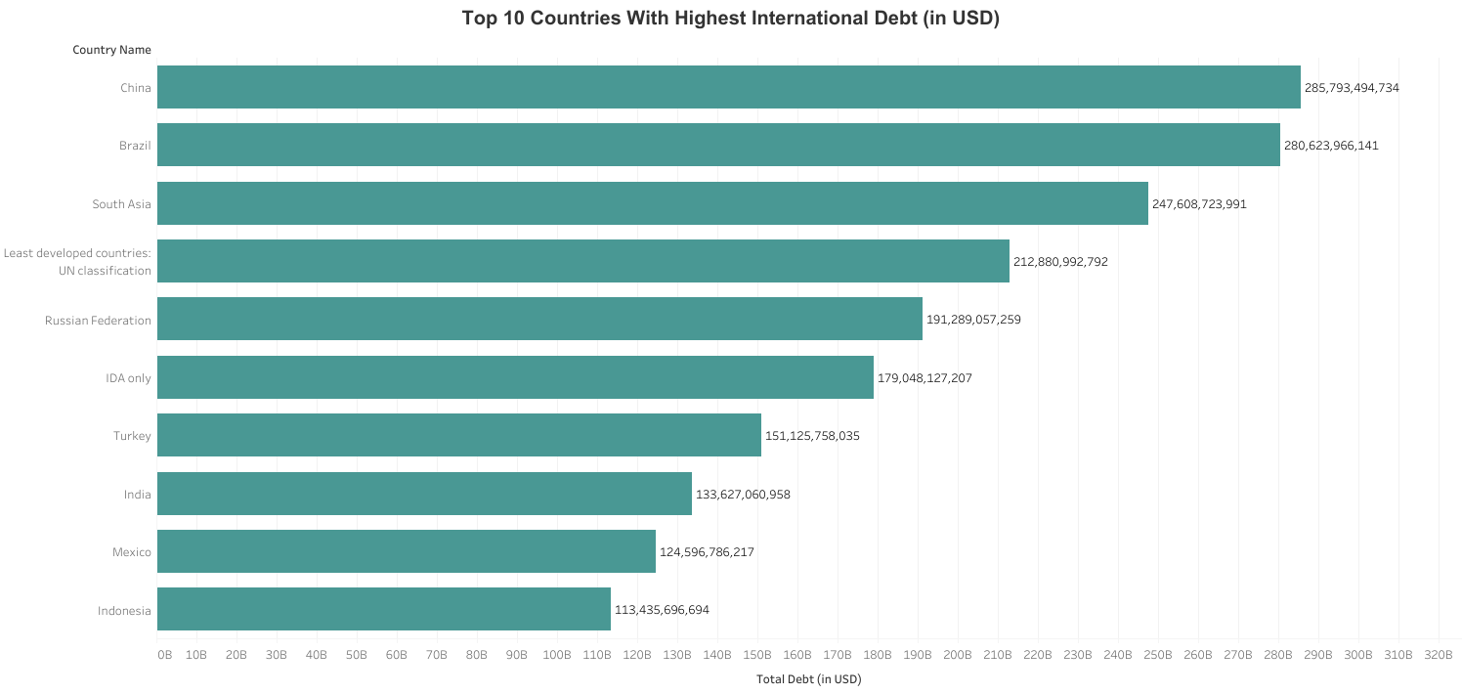
Total debt represents the sum of different debts owed by a country across several categories.
China has the highest total debt which means in has highest principal repayments.

Slide 10
Top 10 Average Debt Per Debt Indicator

Slide 11
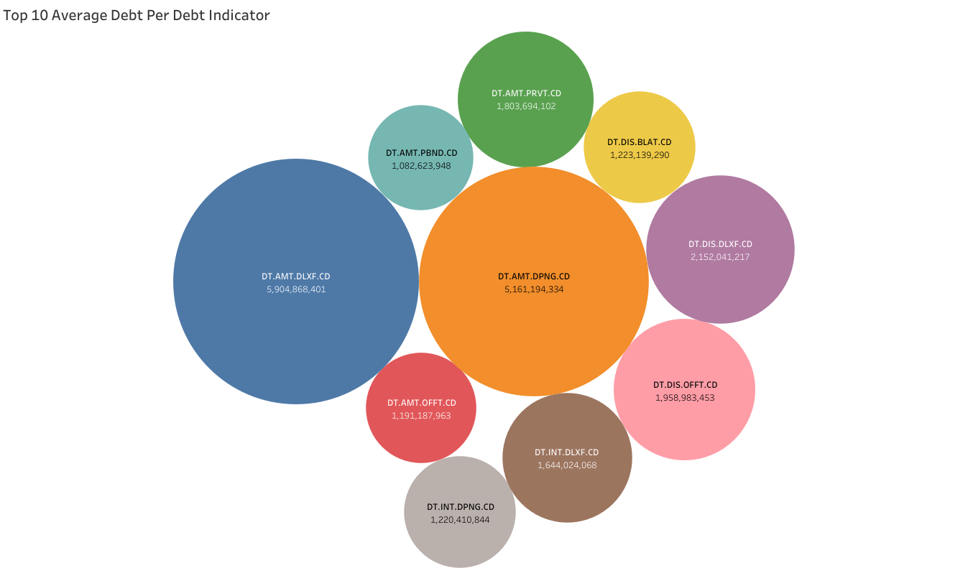
Debt indicator code “DT.AMT.DLXF.CD” has the highest average debt
“DT.AMT.DLXF.CD” is payment of long term debts → this means to get immediate capital, countries take on long-term debt

Slide 12
Top 10 Countries with Maximum Debt Owed Across all Debt Indicators acr

Slide 13
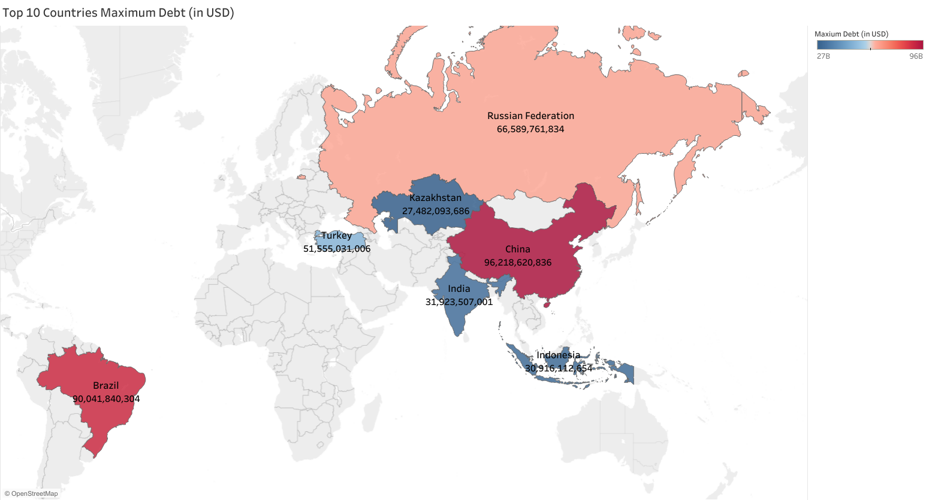
NOTE: This is the maximum debt amount of debt across debt indicators per country not total debt per country
China has the highest maximum debt followed by Brazil
Maximum highest debt after Brazil drops significantly by approximately 23 billion

Slide 14
Conclusion — Key Findings

Slide 15
1
China has the highest total debt across several categories.
2
China has the maximum amount of debt across debt indicators per country
3
Countries have the highest average debt for debt indicator DT.AMT.DLXF.CD.

Slide 16

Q & A
THANK YOU

